Slide 1
P4 Presentation
SW407F13 : SPLAD

Slide 2
Introduction – The Group
Aleksander Nilsson
Christian Jødal O'keeffe
Mette Thomsen Pedersen
Rasmus Fischer Gadensgaard
Niels Brøndum Pedersen
Kasper Plejdrup

Slide 3
Structure of Presentation
Introduction
Language Specification
Implementation
Discussion
Conclusion

Slide 4
Environment
Bars
Replacing bartenders
Optimizing the process
Drink machine
RFID technology
Security

Slide 5
Problem Statement
Problem Statement
”How can a programming language be developed, which makes it suitable for the hobbyist programmer to program drinks machines based on Arduino platforms? ”
Sub-statements

Slide 6
Language Specification
Design Criteria
Syntax
Semantics
Code Examples

Slide 7
Design Criteria
Target group is the hobbyist programmer
Readability is prioritized high
Writeability is not that important

Slide 8
Design Criteria

Slide 9
Syntax Design
Words instead of symbols
|| vs. OR
&& vs. AND
Enviroment inspired types
Drink
Container

Slide 11
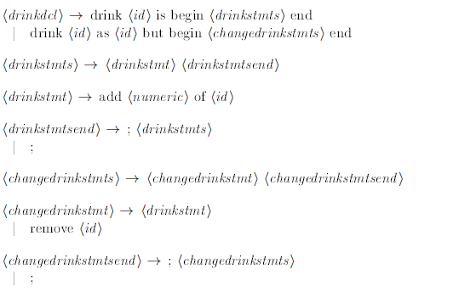

Slide 12
Semantics
Scope Rules
Type Rulse
Transition Rules

Slide 13
Scope Rules
What is a scope?
Local and global variables
Static scoping
Introduced in ALGOL 60
Two categories of statically-scoped languages
Dynamic scoping
Determined at runtime

Slide 14
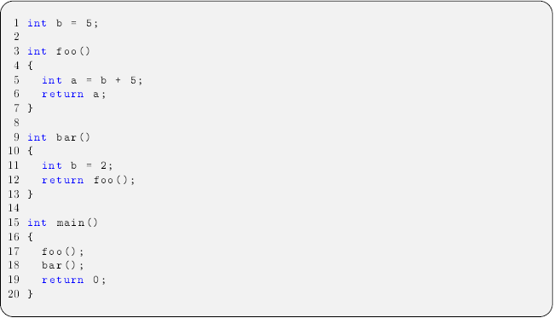
Scope Rules
Dynamic vs. Static Scope
foo() will return 10 i both cases.
bar() will return 10 while using static scoping.
bar() will return 7 while using dynamic scoping.

Slide 15
Scope Rules
In this project
Static scoping is used

Slide 16

Type Rules
Informal type rules
Type rule for ”from to step”-statement:
”from $E_{1}$ to $E_{2}$ step $E_{3}$ begin $S$ end” it type correct if $E_{1}$, $E_{2}$ and $E_{3}$ are type correct and of type integer, and $S$ is type correct.
Formal type rules
$\left[{FROM}_{STM}\right] \frac{E ⊢ e_{1} : Int E ⊢ e_{2} : Int E ⊢ e_{3} : Int E ⊢ S : ok}{E ⊢ from e_{1} to e_{2} step e_{3} do S : ok}$

Slide 17
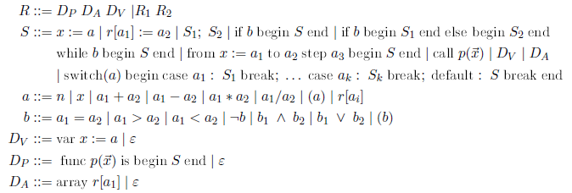
Transition Rules
Abstract syntax

Slide 18

Transition Rules
Transition system
$\left(Γ, →,Τ\right)$
Big-step vs. Small-step semantics
Big-step in our language.
Environment-store model
$l=Loc$ and $Sto=Loc ⇀ ℕ$
Example of transition rules

Slide 19
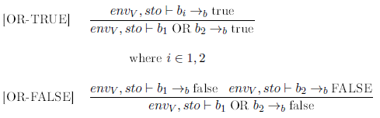
Example

Slide 20
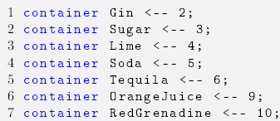
Code examples of SPLAD
Initializing ingredients

Slide 21
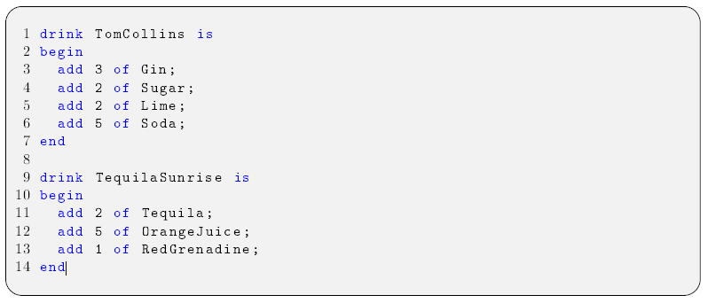
Code examples of SPLAD
Creating a drink like specifying a recipe

Slide 22
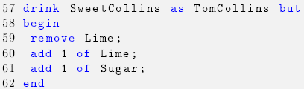
Code examples of SPLAD
Drink inheritance

Slide 23
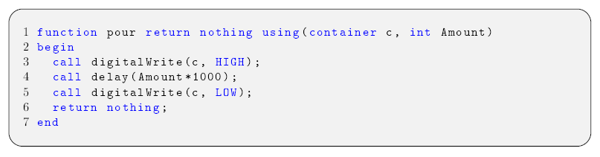
Code examples of SPLAD
Pouring an ingredient

Slide 24
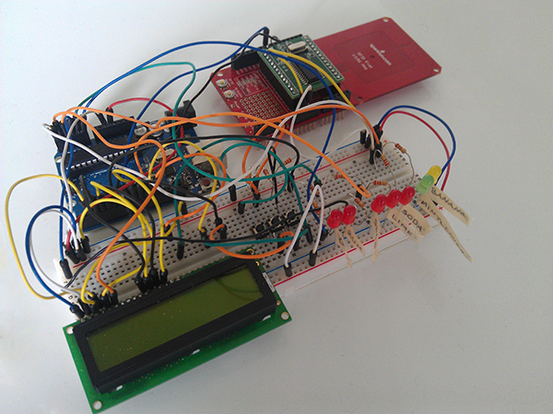
Hardware
RFID-RW
Arduino UNO
Buttons
LED’s
LCD

Slide 25

Hardware
RFID tag
Contains drink ID and drink count
Read by the RFID-RW

Slide 26

Demonstration

Slide 27
Syntactic Analysis
Lexical Analyzer
Top-down Parser
LL(k)
ANTLR
Notes:
Lexical Analyzer
Make a series of tokens
Tokens matched by rules (regular expressions)
Tokens part (type, value)
Top-down Parser
Use token to make a parse tree or abstract syntax tree
LL(k)
ANTLR

Slide 28
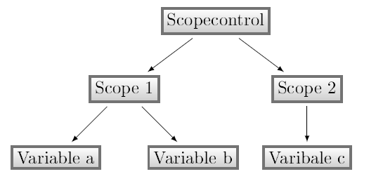
Contextual Analysis
Scope Checking
Type Checking
Notes:
Scope Checking
Type Checking
Tree Traversal
Value class
use boolean to check
return Value
Function class
save name,paremeter, return value
build in function
Variable class
hold (id,type. Value)
bool (constant, isArray)
INDPUT / OUTPUT pre-made
Drink class
check for 2 id
Error Handling
list of errerclass

Slide 29
Compiler – Code Generation
Target code
Visitor pattern
Traverses the parse tree
Provided functions
LCDPrint
LCDClear
RFIDWrite
PourDrink
Implemented types
Drink
Container

Slide 30
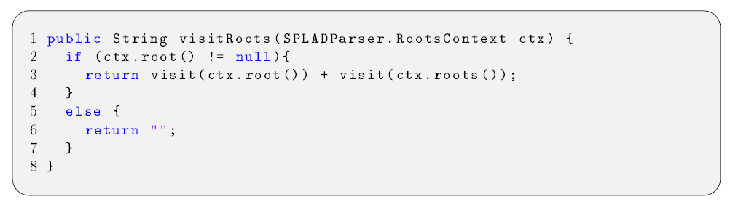
Code Generation – Example Visitor

Slide 31
Compiler – Code Generation
Target code
Visitor pattern
Traverses the parse tree
Provided functions
LCDPrint
LCDClear
RFIDWrite
PourDrink
Implemented types
Drink
Container

Slide 32
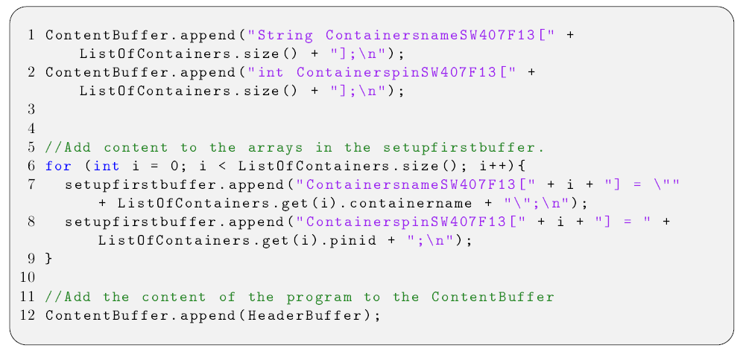
Code Generation – Example of Implementation

Slide 33
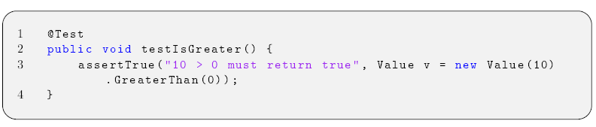
Unit Test
Unit testing in general
JUnit

Slide 34
Unit Test
Code coverage of the Value class
CodeCover plugin
100% code coverage
Statement-coverage
Branch-coverage
Term-coverage

Slide 35
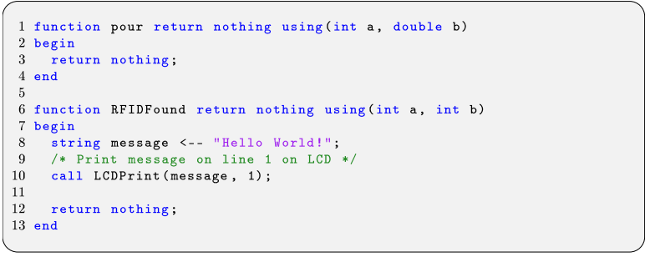
Discussion
Simplicity
SPLAD vs. Arduino C/C++

Slide 36
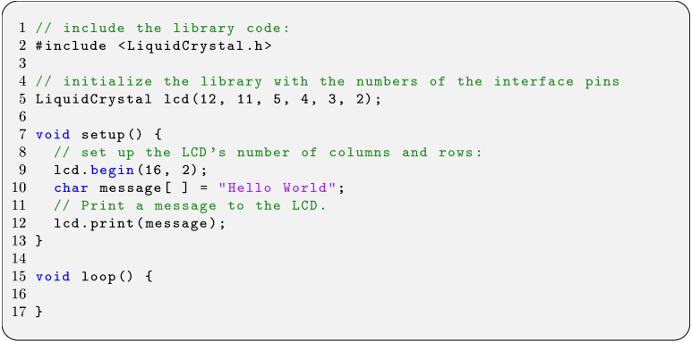
Discussion
Simplicity
SPLAD vs. Arduino C/C++

Slide 37
Discussion
Type checking
Built-in Arduino functions
Error handling

Slide 38
Future works
Compile to machine code
The language types
Security
Error handling
Mulitiple drinks
Only pour

Slide 39
Conclusion
”How can a programming language be developed, which makes it suitable for the hobbyist programmer to program drinks machines based on Arduino platforms?”
Increased readability
No shorthands
The assignment arrow <--
Our compiler

